Slide 1

Sales Performance Analysis of Walmart Stores
Uma Yadav
Batch: 15^{th_june}

Slide 2
Analyze Walmart sales to find insights
Branch performance
Profitable products
Customer segmentation
Sales anomalies
Payment methods
Gender based analysis
Peak sales periods
Repeat customers

Slide 3
Dateset overview
The dataset provided contains detailed transaction data, including customer demographics, product lines, sales figures, and payment methods.
Rows: 1000
Columns: 18
Period: Jan–Mar 2019
Branches: A, B, C
Key Fields: Branch, City, Customer Type, Gender, Product Line, Payment, Sales, Profit

Slide 4
Tools Used
Database: MySQL Workbench 8.0
Methods: Advanced SQL queries, Window Functions( Dense_rank(), NTILE(), CTEs , Date Functions, Subqueries
Visualization: PowerPoint presentation

Slide 5
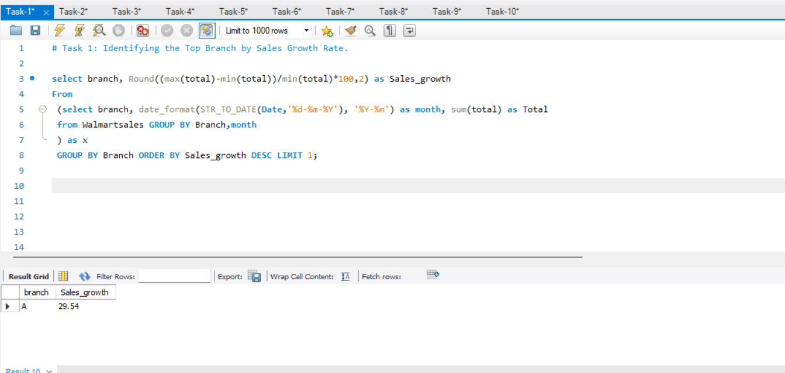
Task 1: Finding top branches by sales growth rate

Slide 6
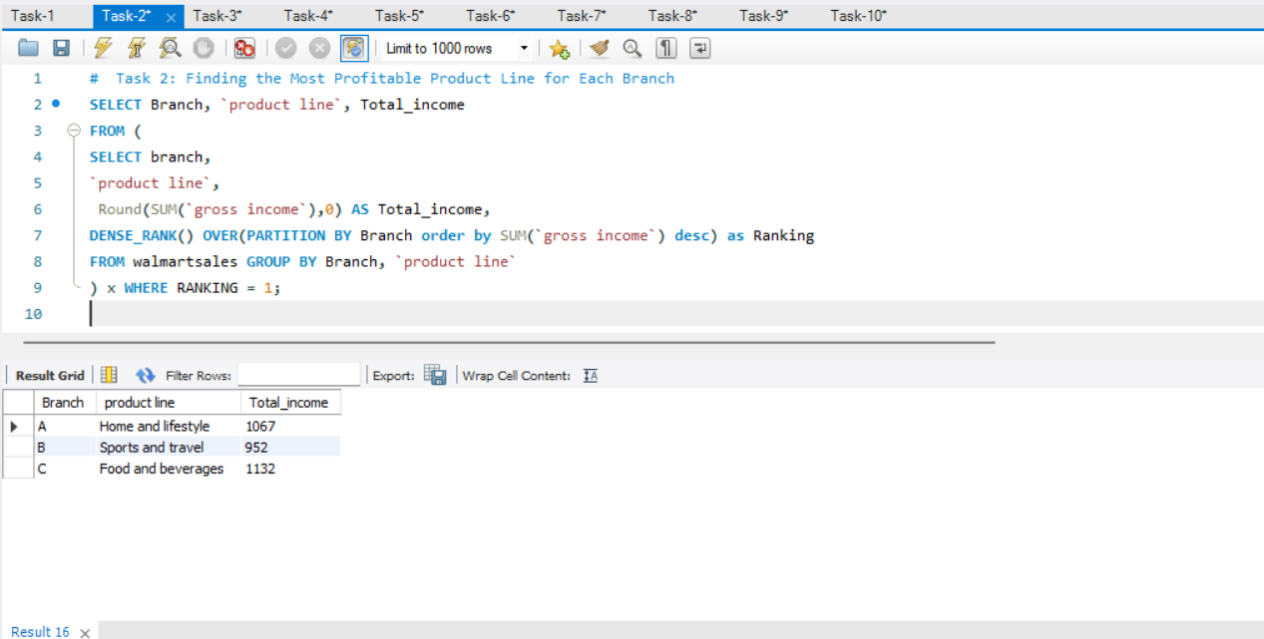
Task 2: Most Profitable Product Line for Each Branch

Slide 7
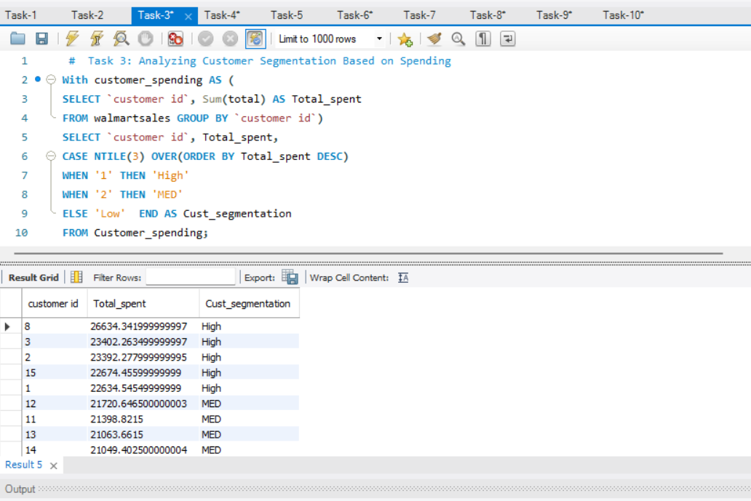
Task 3: Customer Segmentation Based on Spending

Slide 8
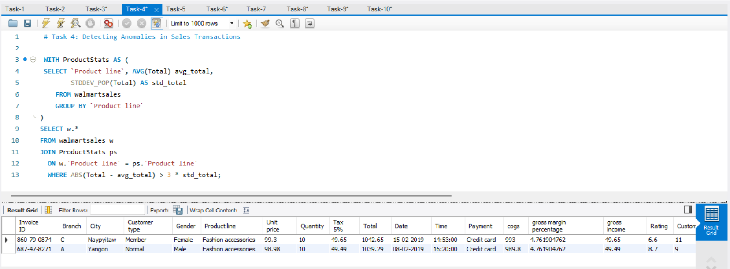
Task 4: Detecting Anomalies in Sales Transactions

Slide 9
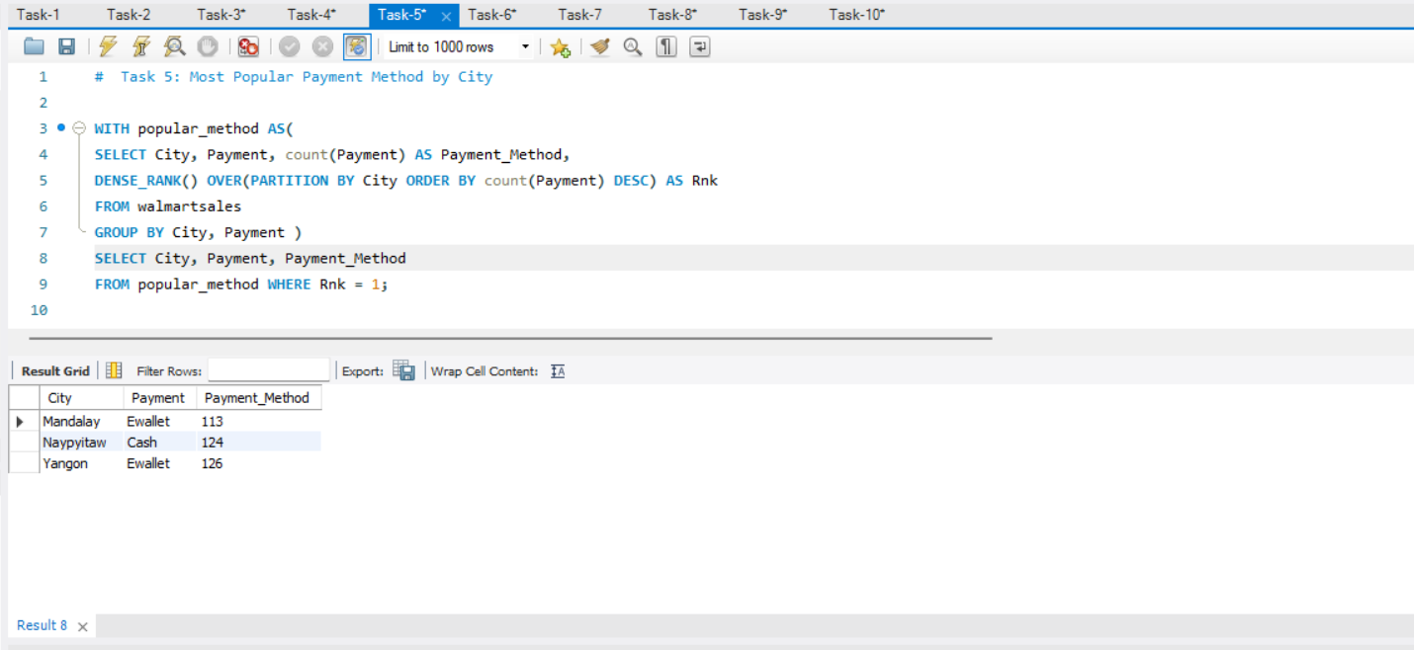
Task 5: Most Popular Payment Method by City

Slide 10
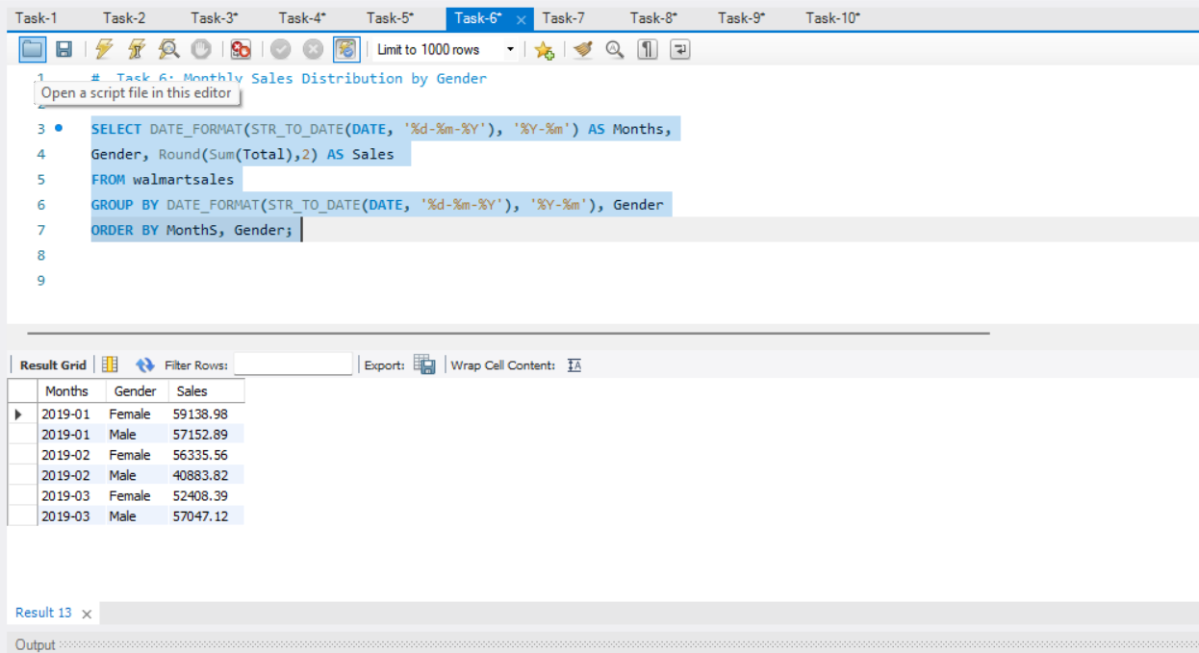
Task 6: Monthly Sales Distribution by Gender

Slide 11
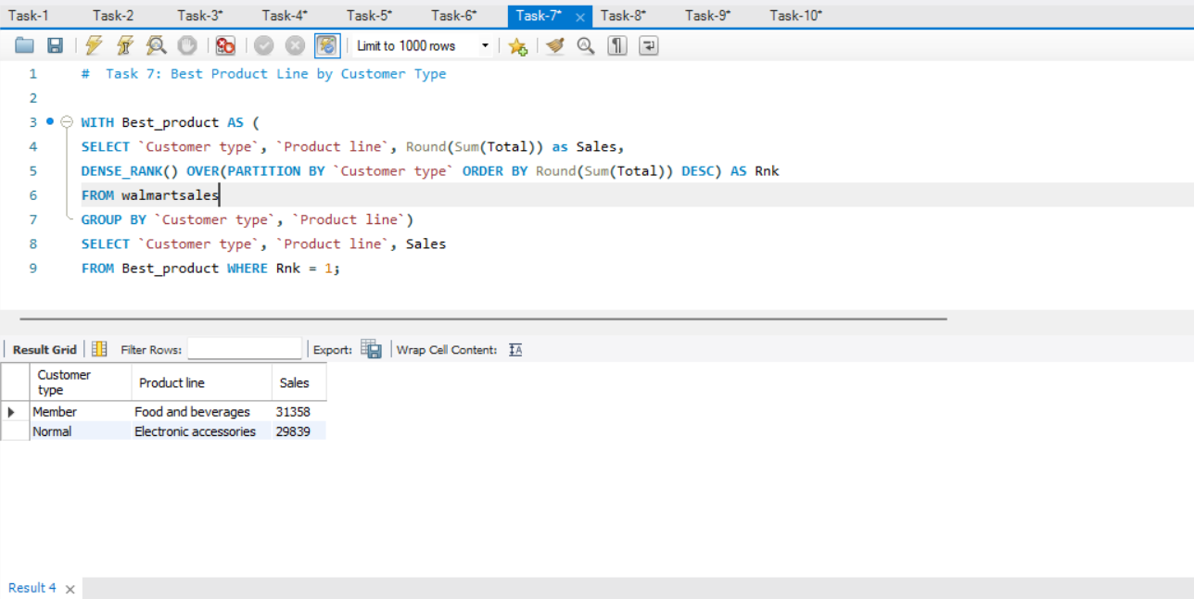
Task 7: Best Product Line by Customer Type

Slide 12
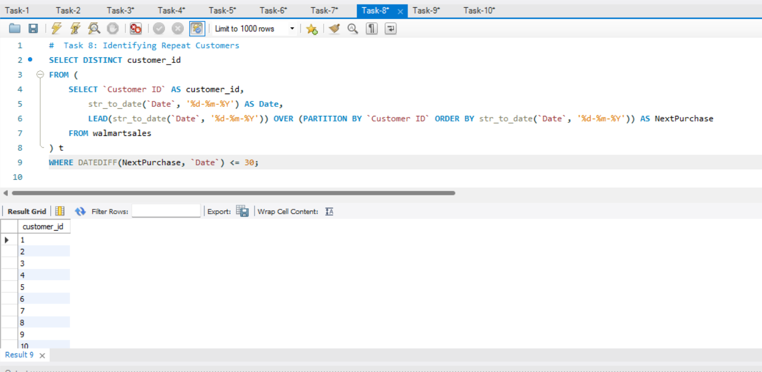
Task 8: Identifying Repeat Customers

Slide 13
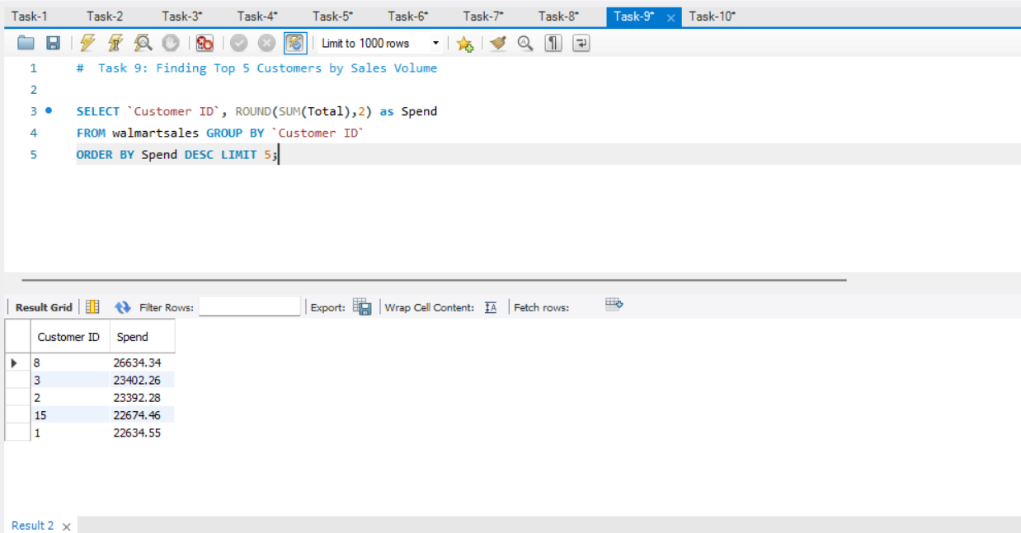
Task 9: Finding Top 5 Customers by Sales Volume

Slide 14
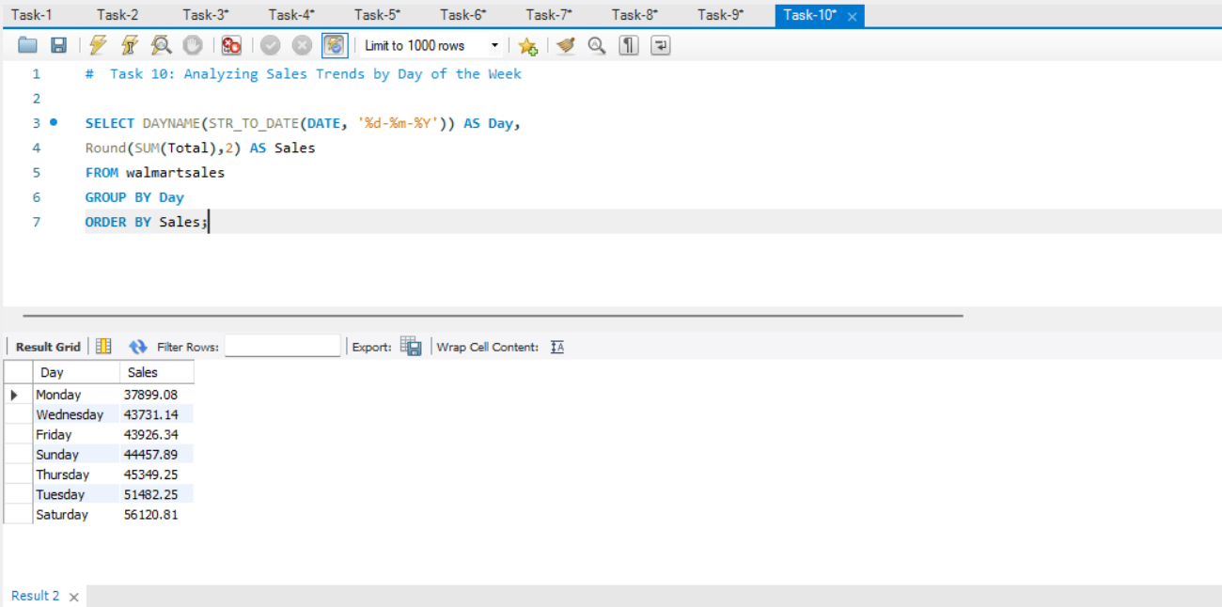
Task 10: Sales Trends by Day of the Week

Slide 15
Observations & Key insights
Branch A has the fastest sales growth
Electronics, lifestyle, & Food are the most profitable product lines
The month of January has the highest revenue
Saturday has the highest sales of the week
Only a small group of customers brings the most revenue

Slide 16
Recommendations for the future:
The analysis identified several actionable strategies to boost sales. Key recommendations include:
Target promotions on Saturday and weekends to leverage high-traffic periods.
Expand profitable product lines at each branch.
Focus on high-spending, repeat customers to increase customer lifetime value.
Promote underused payment methods in specific cities.
Launch offers and discounts on weekdays to attract more customers.

Slide 17
Future Actions:
As the data only covers three months(Jan – March), it might not represent a full sales cycle; extend the analysis to a full year to capture seasonal and holiday sales patterns.
Focus on the areas and branches that are not performing well.

Slide 18
Thank you
Video explanation: DRIVE LINK
Presented by: Uma Yadav

